Slide 1
Chinese dessert making
Passionate Pursuit, Fall 2015
Judy Xu

Slide 2
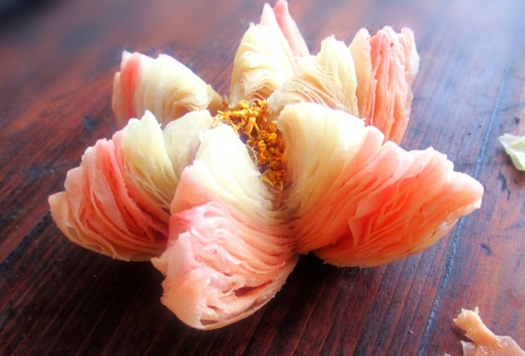
Comparing to western desserts
Different flour
Gluttonous rice flour
Mung bean flour, etc
Less reliant on diary and eggs
Use more vegetables and fruits (root vegetables, beans, dates)
Healthier
Low fat, oil and artificial sugar
Many desserts contain traditional Chinese medicine ingredients
Also have puff pastries!
Egg tart crust, lotus pastry
Often uses lard instead of butter or shortening
No chocolate… ☹
Lotus pastry from the beautiful ‘River South’

Slide 3
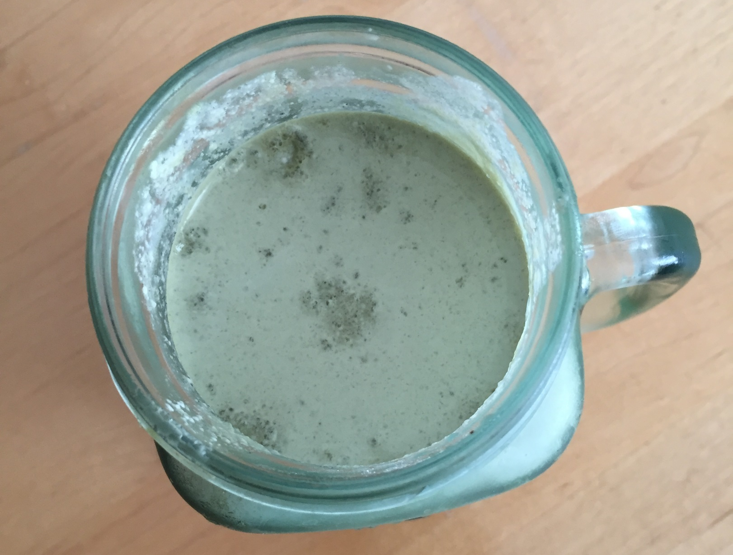
Green tea tofu pudding

Slide 4
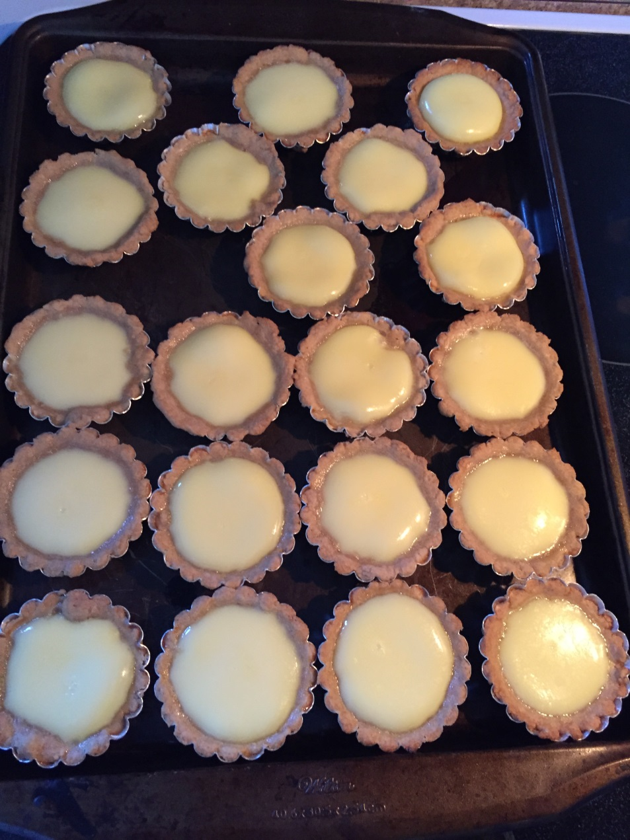
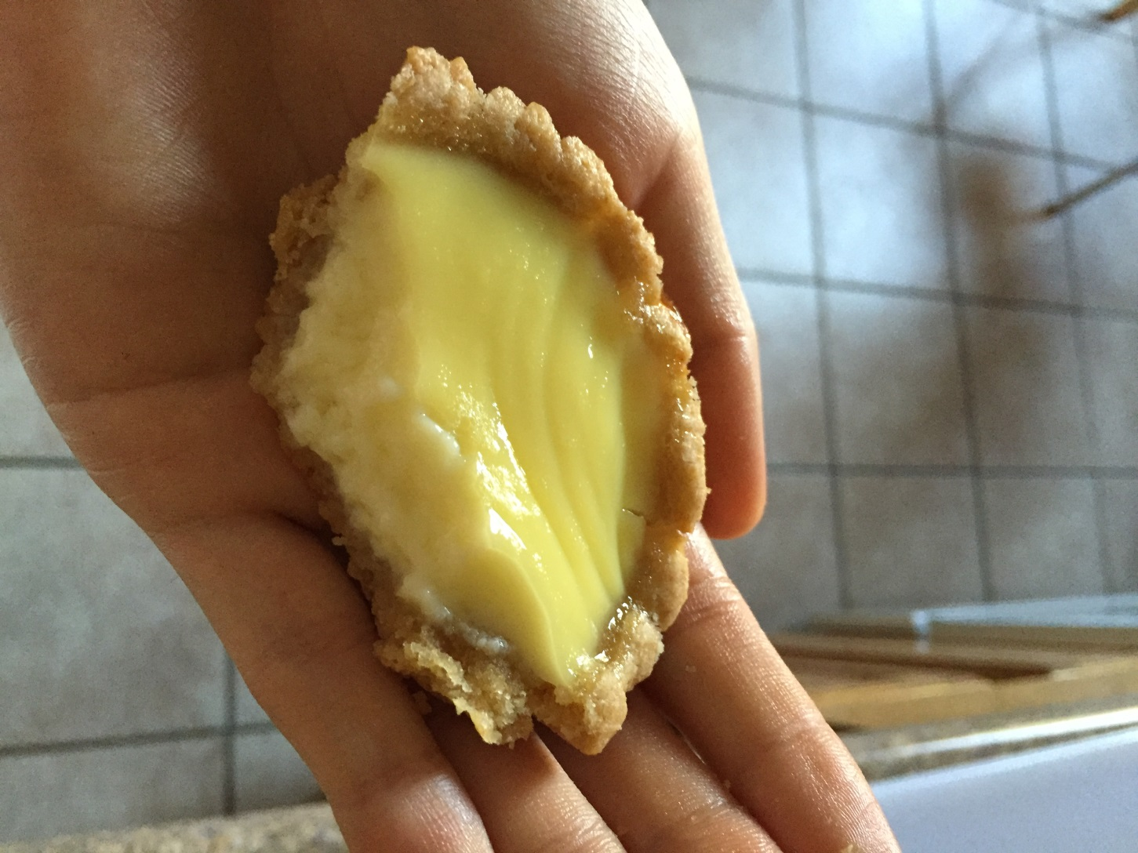
Egg tarts

Slide 5
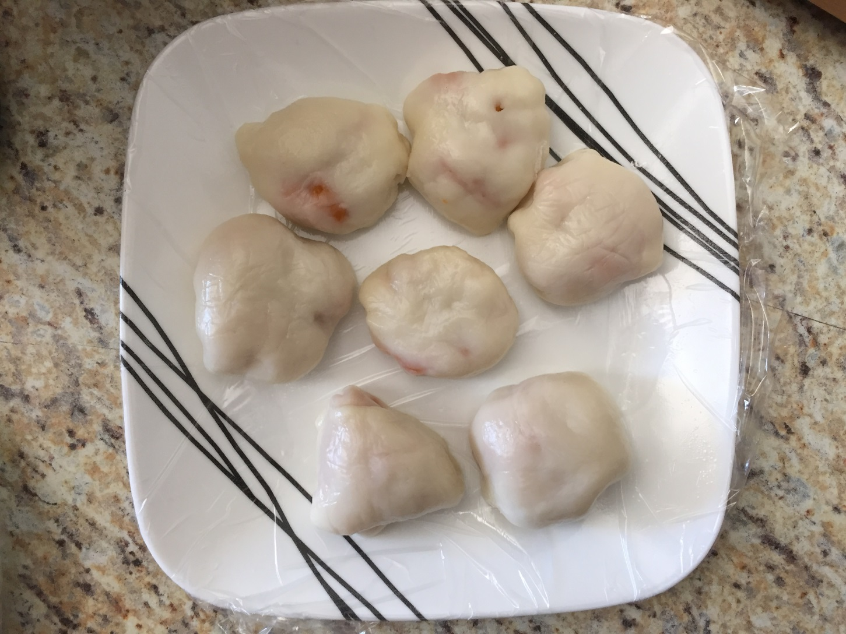
Sweet potato snowy mooncakes

Slide 6
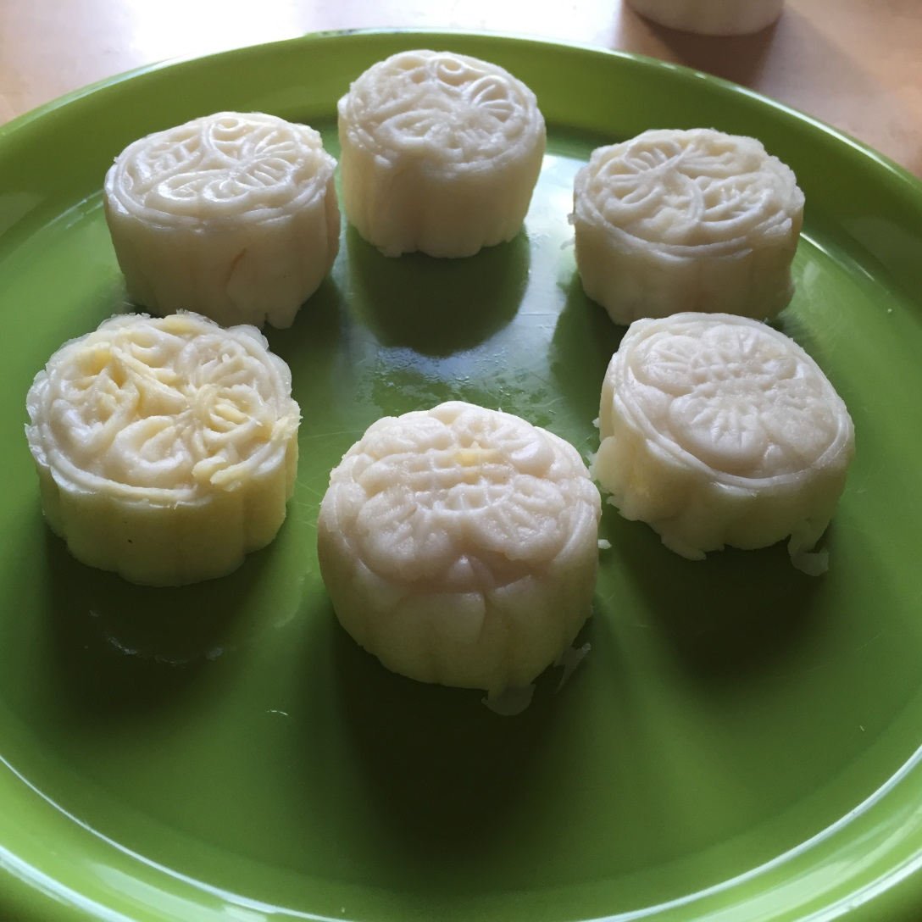
Custard snowy mooncake

Slide 7
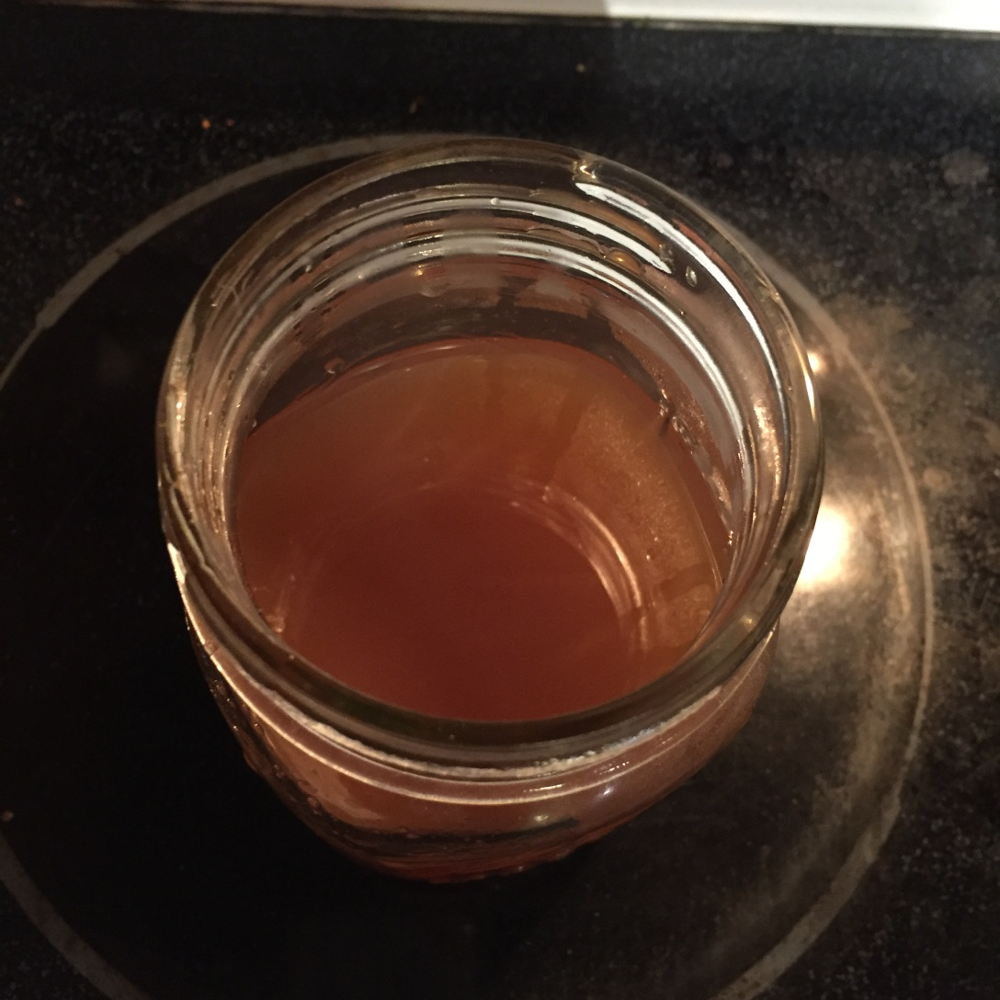
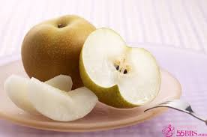
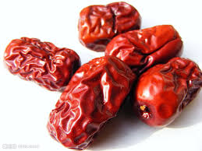
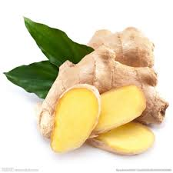
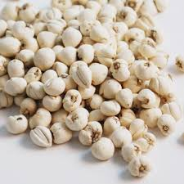
Qiu li gao (Autumn Pear honey)

Slide 8
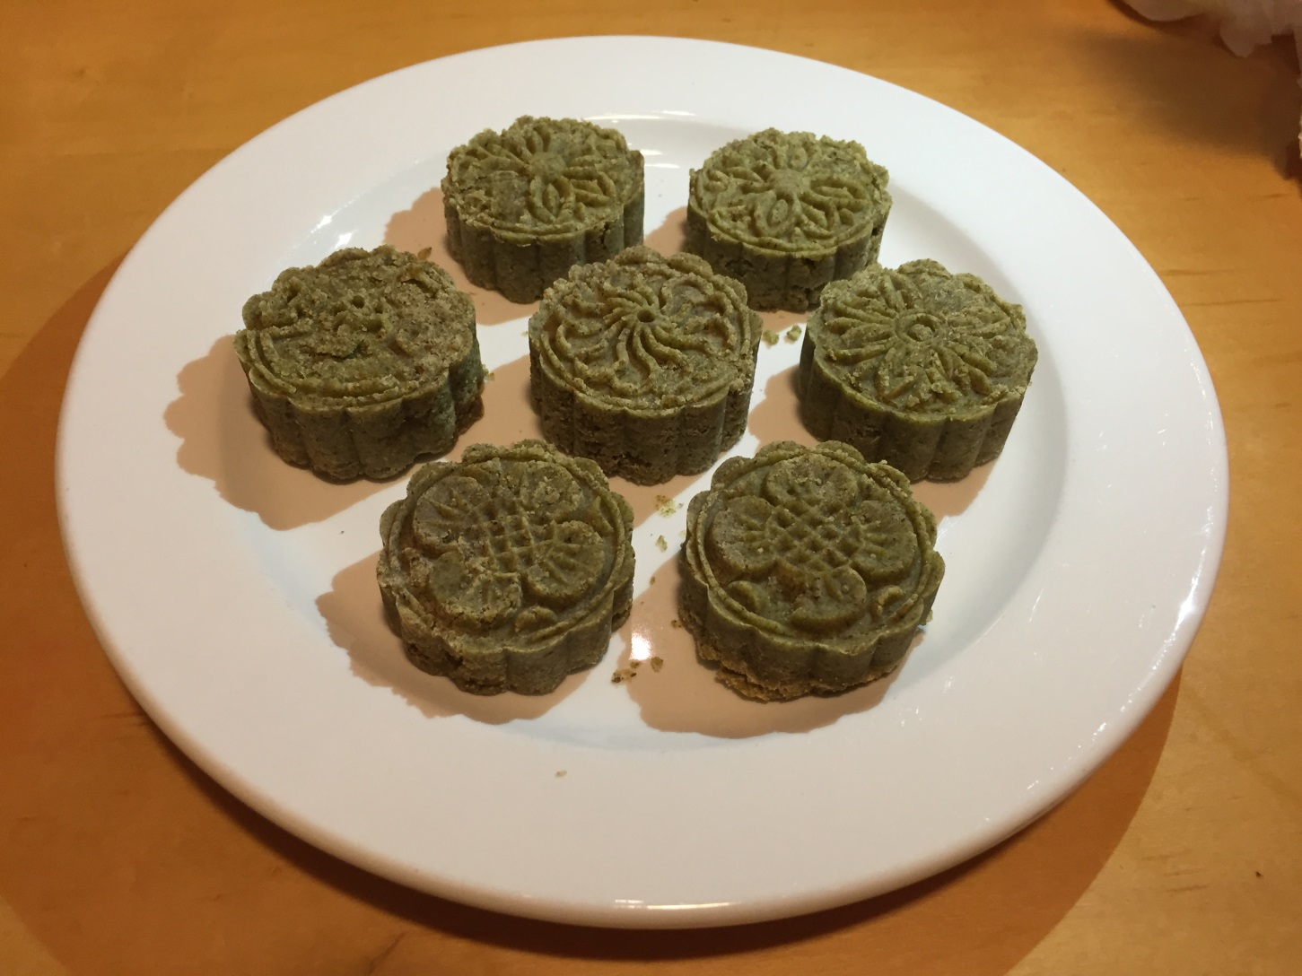
mung-bean cake

Slide 9
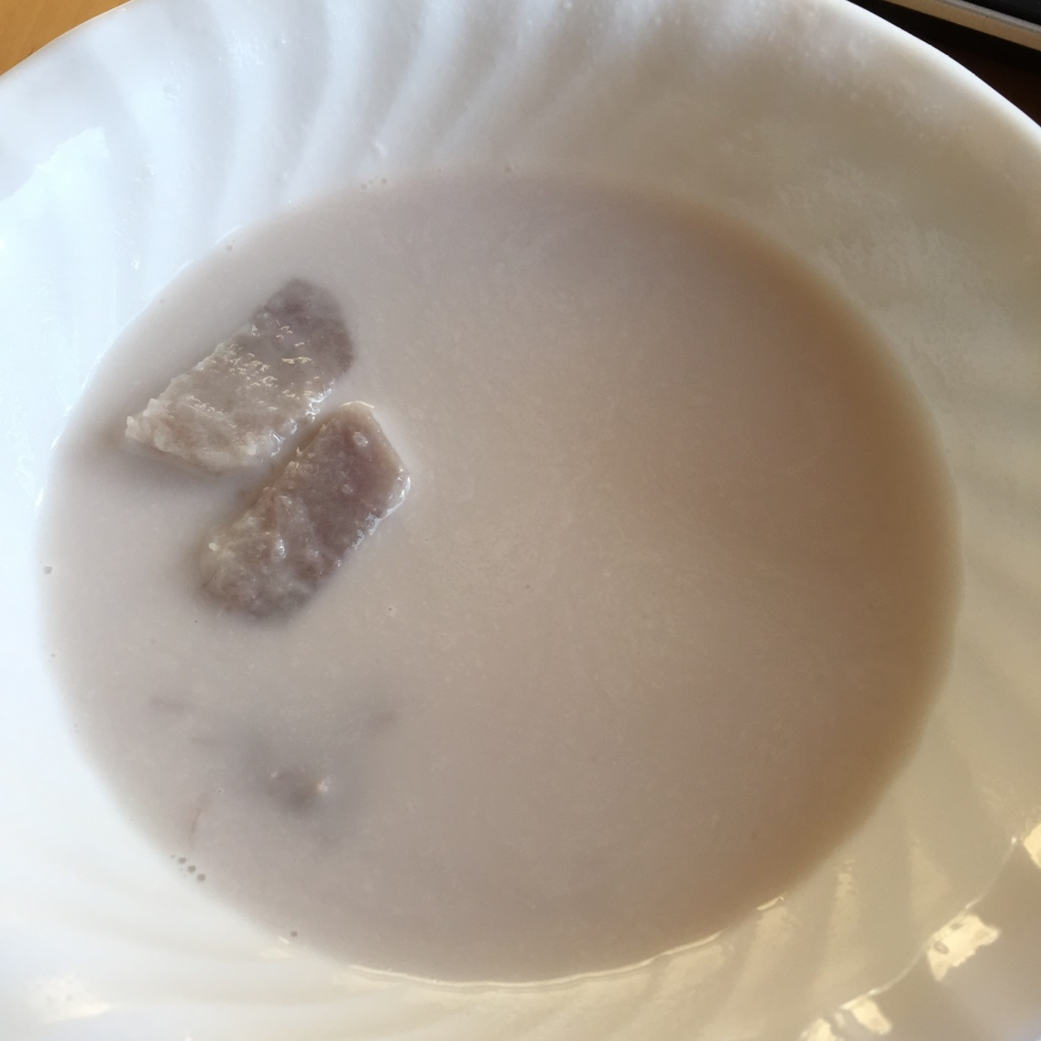
sweet Taro black rice coconut milk

Slide 10
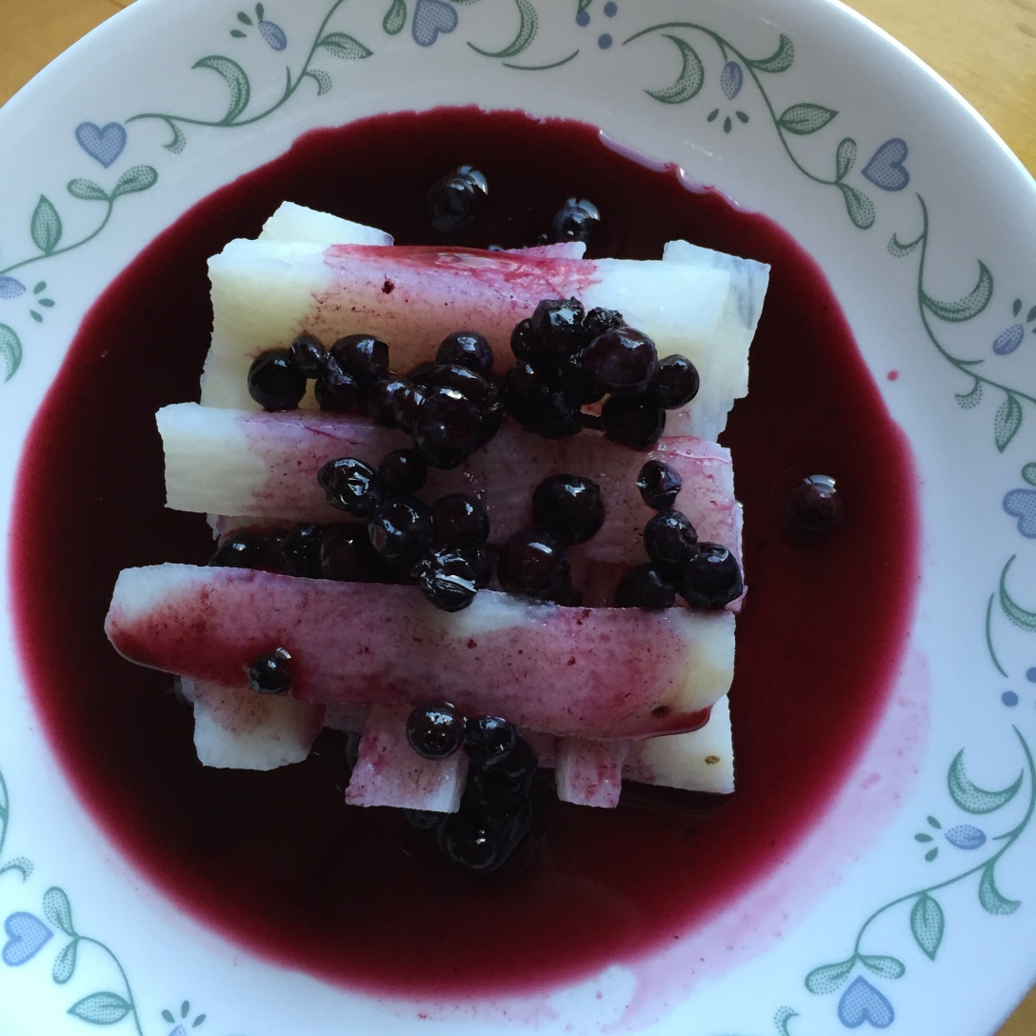
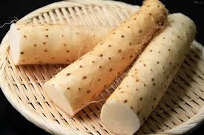
Blueberry Chinese yam

Slide 11
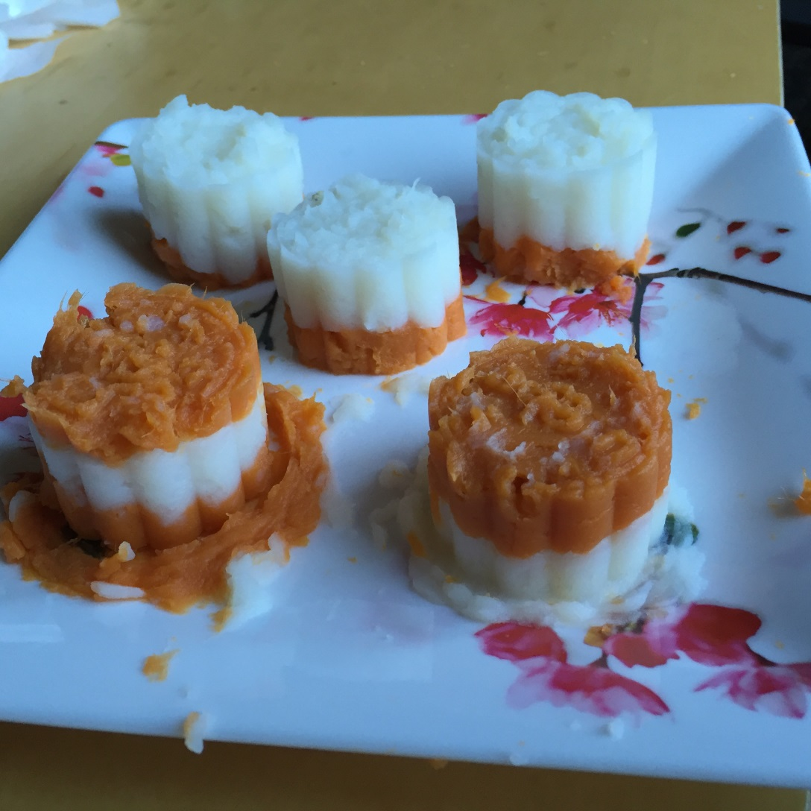
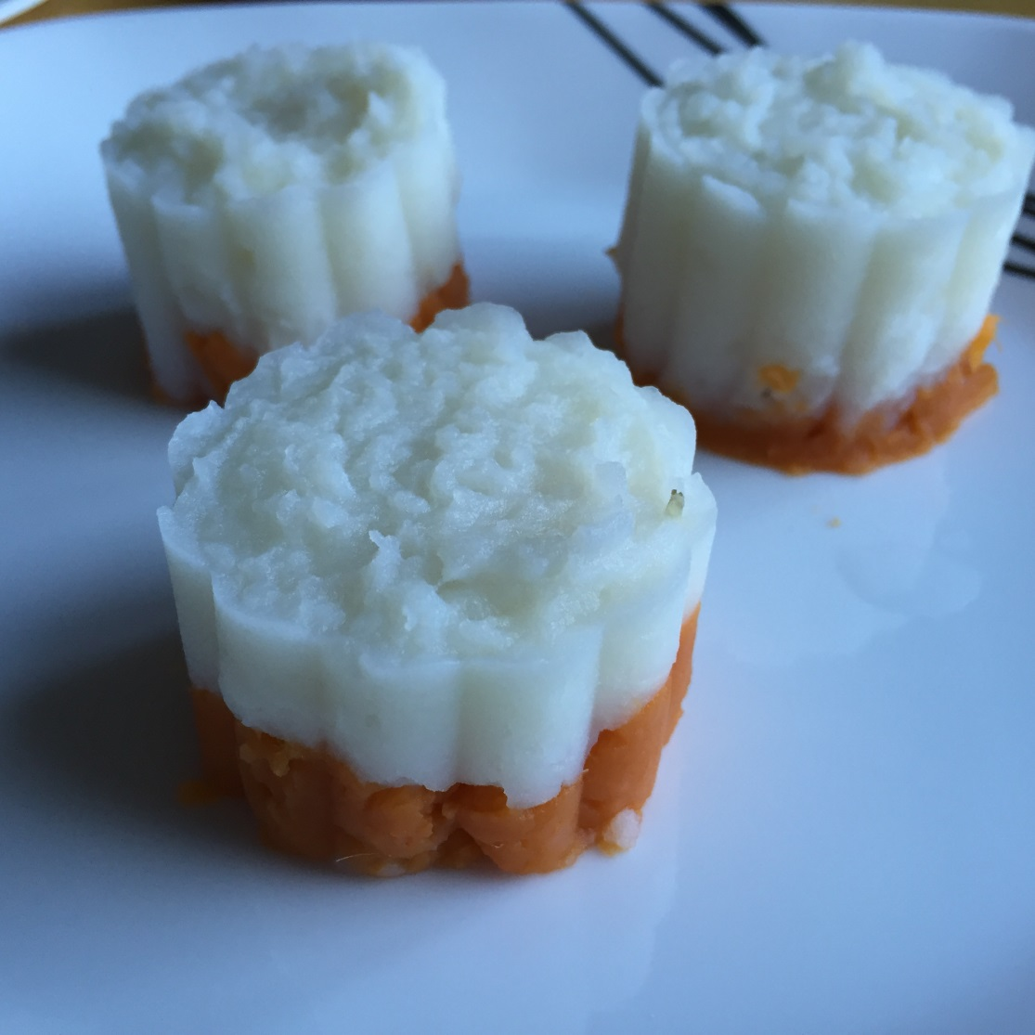
Double yam cake

Slide 12
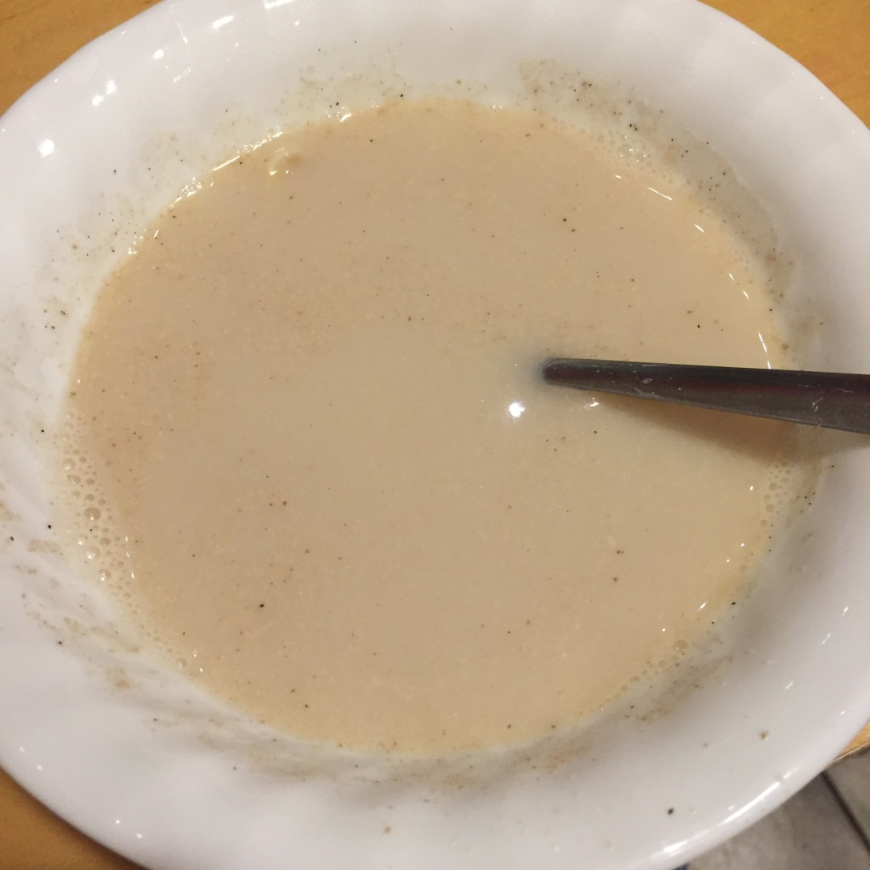
Sweet walnut milk

Slide 13
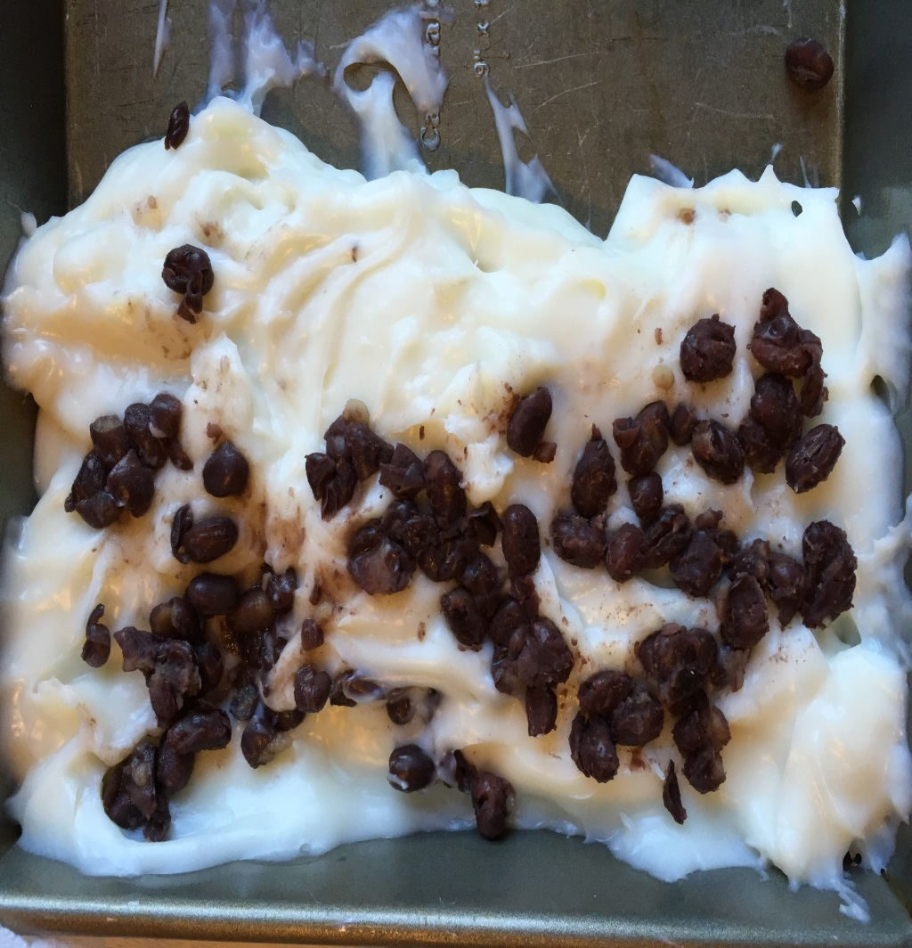
Please try some!
Coconut red bean pudding

